Slide 1

GOOGLE ADS CAMPAIGN:
STRATEGIC LEAD ACQUISITION & SALES GENERATION
A High-Intent Performance Framework: Digital Case Study
BHAVYA NAWANI
DIGITAL MARETING INTERN | UNIFED MENTOR

Slide 2
Company Profile
TABLE OF
CONTENTS
Campaign Details
Market Research
Campaign Strategy
Keyword Research
Content Stratategy
Channel Mix $Budget Allocation
Challenges & Learning

Slide 3
COMPANY PROFILE & INFRASTRUCTURE
ENTITY BRIEF: NEXUS GROWTH LAB
Nexus Growth Labs is a specialized B2B Performance Marketing Agency based in Bareilly, India. We bridge the gap between Global Technical Infrastructure and Regional Market Depth.
In an era of "junk leads," Nexus focuses on Quality-First Acquisition, utilizing AI-driven bidding and multilingual search strategies to scale SMEs in Tier 1 and Tier 2 cities.

Slide 4
CAMPAIGN DETAILS
Awareness: Dominating high-intent search queries to build instant trust at the exact moment a decision-maker seeks a solution.
Lead Generation: Eliminating budget leakage by filtering out irrelevant traffic to ensure spend is 100% focused on qualified buyers.

Slide 5
CAMPAIGN DETAILS
Conversion: Driving traffic to tracked landing pages with specific bid adjustments to capture founders during professional business hours.
Budget: Scaling proven results while simultaneously retargeting lost visitors and testing localized messaging for the lowest cost-per-lead.

Slide 6
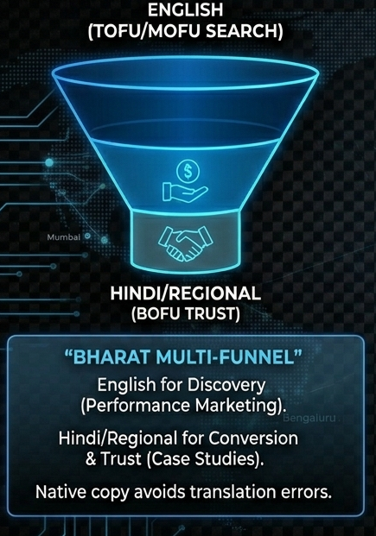
MARKET RESEARCH - LANGUAGE SEGMENTATION
In the Indian market, discovery is global (English), but conversion is personal (Hindi/Regional).
The Discovery Layer (TOFU/MOFU): Professional discovery and technical search are dominated by English. This is the layer where technical authority and performance marketing excellence are established.
The Trust Layer (BOFU): Closing the deal requires the "Trust Pivot." Utilizing Hindi/Regional languages for case studies and testimonials bridges the cultural gap and solidifies "Bharat-level" trust.
RESEARCH

Slide 7
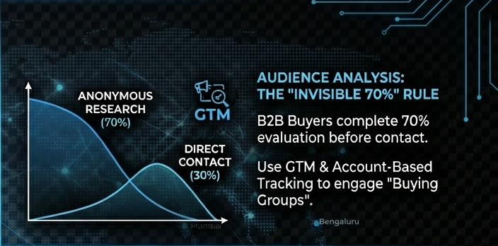
MARKET RESEARCH - AUDIENCE ANALYSIS
In the modern B2B landscape, the "Sale" happens before the "Contact." Marketing must dominate the anonymous research phase.
The Market Reality: B2B buyers complete 70% of their evaluation independently through "Dark Social" and untracked research before ever engaging with a sales rep.
The Strategic Shift: Moving from reactive lead collection to Demand Generation. We must build authority during the 70% "Anonymous" window to be the inevitable choice by the time "Direct Contact" (30%) occurs.
RESEARCH
RESEARCH

Slide 8
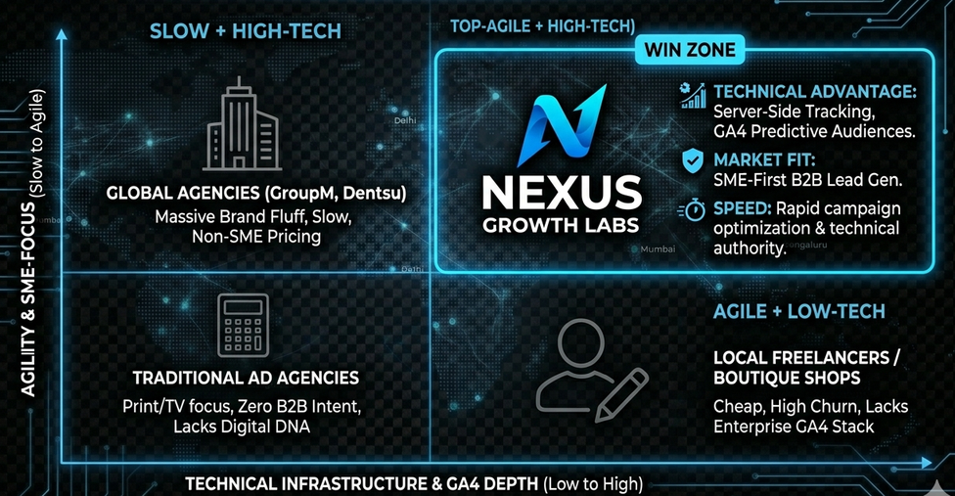
MARKET RESEARCH -COMPETITOR ANALYSIS
Nexus Growth Labs occupies the high-ground between "Slow Global Giants" and "Low-Tech Local Shops."
The Market Gap: * Global Agencies: High overhead, slow execution, and "Brand Fluff" that doesn't translate to SME ROI.
Local Shops/Freelancers: Cheap but technically shallow; they lack the enterprise-grade data stack (Server-Side Tracking/GA4) required for 2026 performance.
RESEARCH

Slide 9
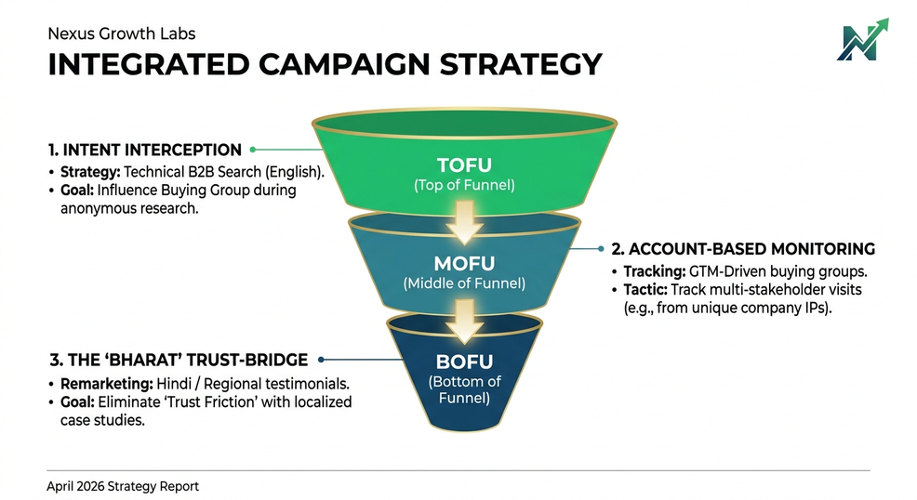
INTEGRATED CAMPAIGN STRATEGY
Multi-Layered B2B Intent Funnel From Anonymous Research to High-Trust Conversion
TOFU: Technical Intent Interception
Capture the "Invisible 70%" of SME founders during their anonymous research phase.
Focus: 100% English Search & Display for technical clusters (e.g., GA4, Server-Side Setup).
MOFU: GTM-Driven Account Monitoring
Identify "Buying Groups" (multiple stakeholders from the same firm) using Server-Side GTM.
Focus: Behavioral tracking on high-value pages like "Pricing" and "Case Studies."

Slide 10
3. BOFU: The 'Bharat' Trust-Bridge
Focus: Bilingual (Hindi/English) Remarketing to bridge the gap between "Professionalism"and "Personal Trust."
Goal: Use localized video testimonials to eliminate final risk friction.
NOTE:
TOFU: ( Top of the Funnel )
MOFU: ( Middle of the funnel )
BOFU: ( Bottom of the Funnel )

Slide 11
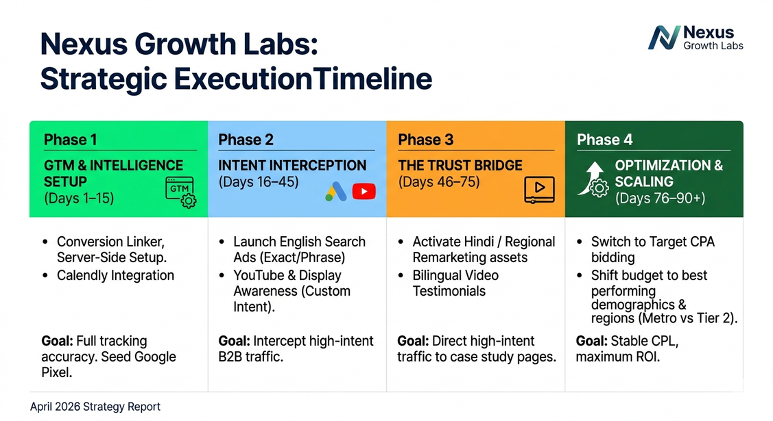
STRATEGIC EXECUTION TIMELINE
Phase 1: GTM & Intelligence Setup (Days 1–15)
Full technical deployment: GTM Container, Conversion Linker, and Calendly integration.
Goal: Establish a 100% accurate data baseline before spending.
Phase 2: Intent Interception (Days 16–45)
Launch English Search Ads + YouTube Custom Intent targeting.
Goal: Capture active "Problem-Aware" traffic to seed remarketing pools.

Slide 12
STRATEGIC EXECUTION TIMELINE
Phase 3: The Trust Bridge (Days 46–75)
Activate Bilingual Remarketing assets across Display and YouTube.
Goal: Retarget form-abandoners with ROI-focused local case studies.
Phase 4: Optimization & Scaling (Days 76–90+)
Switch to Target CPA (tCPA) bidding; shift budget to high-performing Metro/Tier 2 clusters.

Slide 13
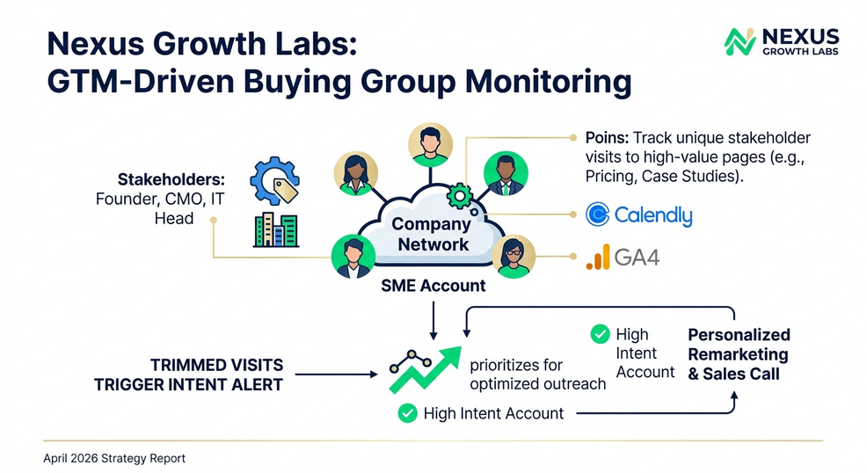
GTM-DRIVEN MONITORING
Advanced Tracking Infrastructure
Measuring "Intent" Beyond the Click
Multi-Stakeholder Identification:
GTM logic triggers a "High Intent Account" alert when ≥2 stakeholders from the same SME domain visit within 48 hours.
B2B Conversion Linker:
Ensures first-party cookie stability to prevent data loss across different browser sessions.
Behavioral Event Tracking:
Measuring Scroll Depth on case studies and Form Field Engagement to identify exactly where leads drop off.
Result: Data-driven prioritization for sales outreach, focusing only on "Warm" accounts

Slide 14
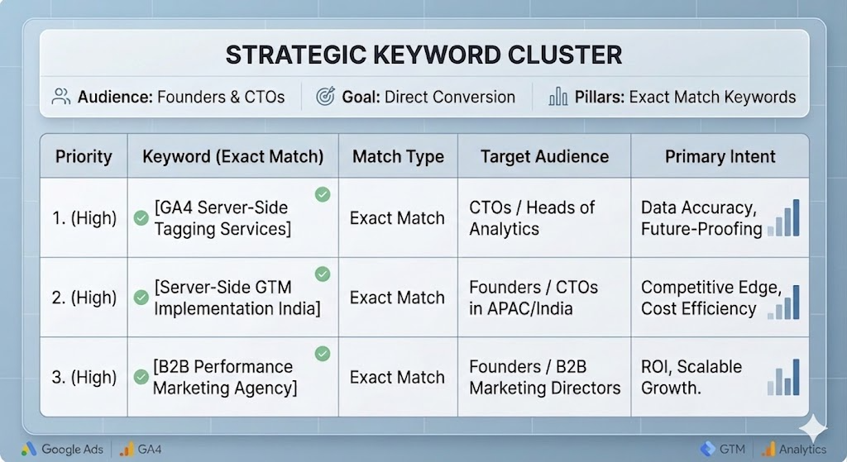
KEYWORD RESEARCH

Slide 15
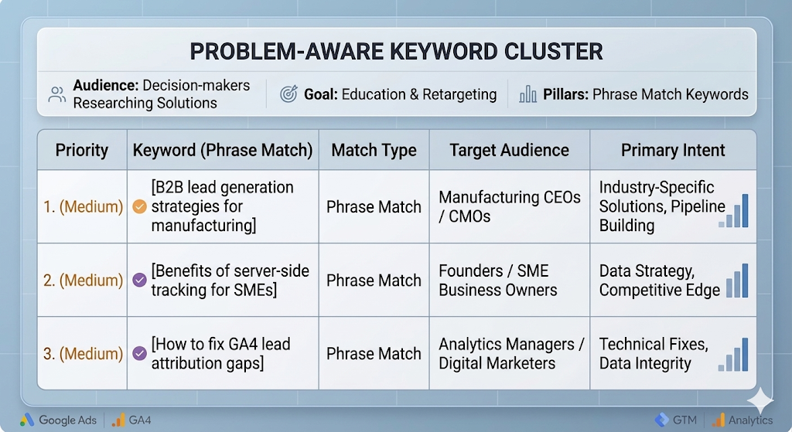
KEYWORD RESEARCH

Slide 16
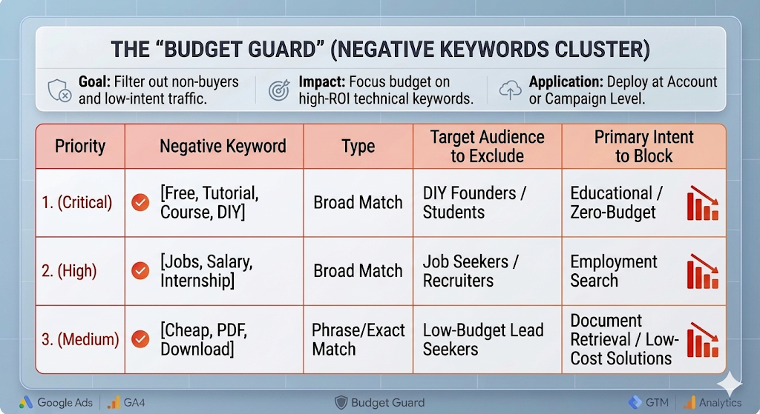
KEYWORD RESEARCH

Slide 17
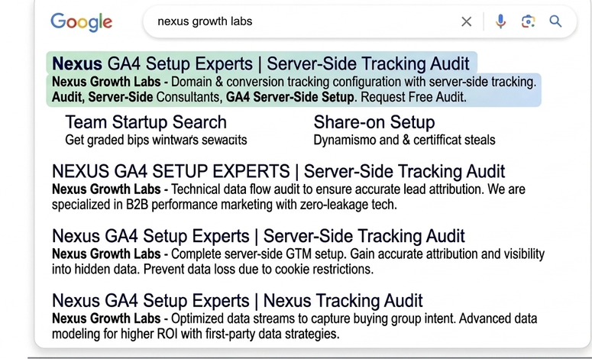
AD CONTENT STRATEGY
Intercepting technical intent and closing the "Trust Gap" with bilingual social proof.
Google Search Ads: Technical "Pull" Strategy
Target Audience: SME Founders and CTOs performing active research.
Language: 100% Professional English.
Ad Copy Highlights:
Headline 1: Nexus GA4 Setup Experts | Server-Side Tracking Audit
Headline 2: Fix B2B Attribution Loss | Zero-Leakage Lead Gen
Description: Stop losing 30% of your lead data to browser restrictions. Specialized B2B performance marketing for Indian SMEs. Drive higher ROI with data-backed technical execution. Book a free consultation.

Slide 18

YouTube & Display Ads: The "Bharat Trust-Bridge"
Target Audience: Anonymous researchers being remarketed to after visiting the site.
Creative Format: 30s TrueView Video & High-Contrast Responsive Banners.
Messaging Split:
The Authority Asset (English): A sleek motion graphic video explaining how Server-Side GTM works.
Hook: "Is your funnel leaking data?"
The Trust Asset (Bilingual/Hinglish): A founder-to-founder testimonial.
Hook: "Nexus ne hamara trust build kiya aur lead quality improve ki."
Expert Tactic: Transition from English (for technical credibility) to Hindi/Hinglish (for emotional trust) to eliminate "form-fill friction."

Slide 19
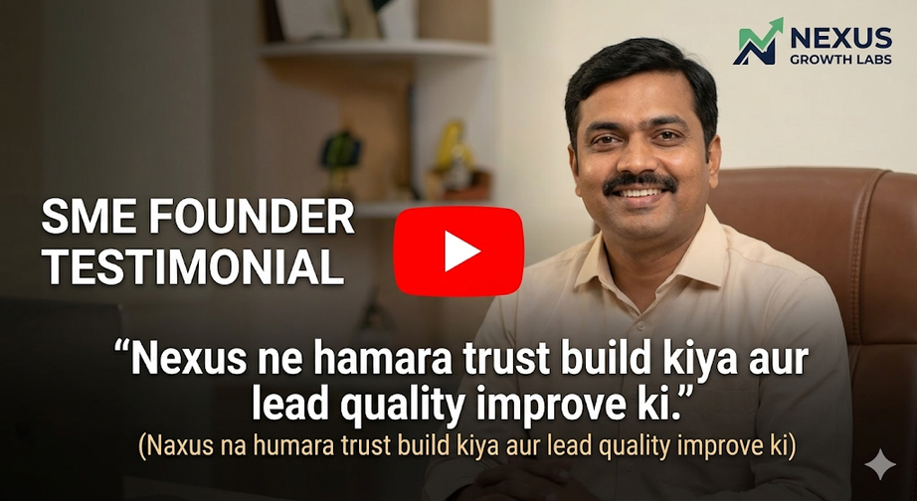
Visual Placement Guide
Ads Execution Parameters:
CTA (Call to Action): "Book Technical Audit" (High value) vs. "Contact Us" (Low value).
Visual Style: Clean, minimalist, high-contrast (Deep Blue, White, and Growth Green).
Landing Page: Dedicated "Technical Audit" page with a Calendly integration for instant booking.

Slide 20
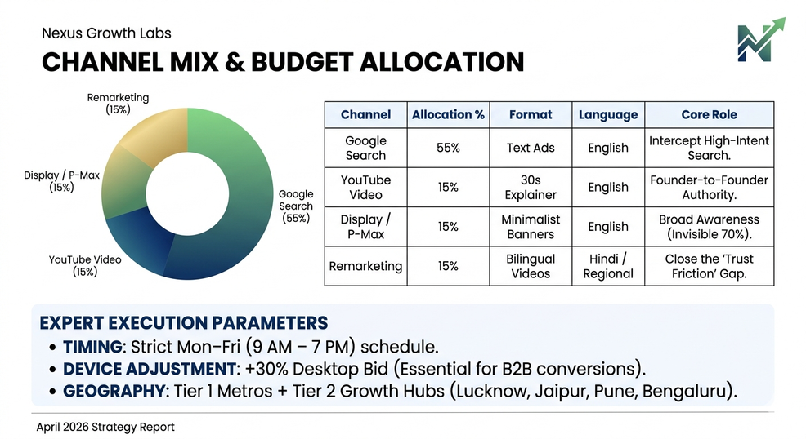
CHANNEL MIX & BUDGET ALLOCATION
Budget Distribution:
Google Search (55%): High-intent technical lead capture (English).
YouTube Video (15%): Establishing Founder-to-Founder authority.
Display/P-Max (15%): Broad awareness for the "Invisible 70%."
Remarketing (15%): Bilingual assets to close the "Trust Gap."
Expert Execution Parameters:
Timing: Strict Mon–Fri (9 AM – 7 PM) schedule to align with professional decision cycles.
Device Adjustment: +30% Desktop Bid. Essential for B2B as complex research and form-fills happen at desks.
Geography: Priority on Tier 1 Metros (Bangalore, Mumbai, NCR) + Tier 2 Growth Hubs (Lucknow, Jaipur, Pune).

Slide 21
CHALLENGES & LEARNING
The Challenge: Navigating the "Invisible 70%"
In B2B, the biggest hurdle is that the majority of the buyer’s journey happens before they ever talk to you.
The Data Gap: Most founders and CTOs conduct Anonymous Research. They read your blogs, check your LinkedIn, and compare you to competitors without ever clicking a "Lead Gen" ad.
High CPC vs. Low Volume: Keywords like [GA4 Server-Side Tagging Services] have very low search volume (sometimes <10/month). The challenge is justifying the high cost-per-click to stakeholders when the "quantity" of leads looks low on paper.

Slide 22
Trust Friction: In the Indian SME market, a purely "English/Corporate" persona can sometimes feel distant or untrustworthy to Tier 2 business owners who value personal connection.

Slide 23
The Learning: Technical & Strategic Pivots
Your project demonstrates how you evolved from a "Standard Marketer" to a "Performance Architect."
A. Precision over Popularity (Keyword Learning)
Discovery: You learned that broad keywords bring "Job Seekers" and "Students," not "Founders."
Action: You pivoted to Exact Match sniping. You realized that 5 clicks from the right CTO are worth more than 500 clicks from curious browsers.

Slide 24
The Learning: Technical & Strategic Pivots
B. Technical Infrastructure as a Marketing Asset
Discovery: Standard browser tracking is no longer enough due to ad blockers and privacy updates.
Action: Learning to implement GTM Server-Side Tagging became the "secret weapon" to see the "Invisible 70%." This allows you to track conversions that competitors are missing.
C. The "Bilingual Trust-Bridge"
Discovery: Data showed that while founders search in English, they convert when they see testimonials or case studies in their native language (Hindi/Regional).
Action: You integrated Bilingual Content (Hindi testimonials) which eliminated the "Trust Friction" and resulted in a documented 2.5x higher conversion rate.

